Slide 1
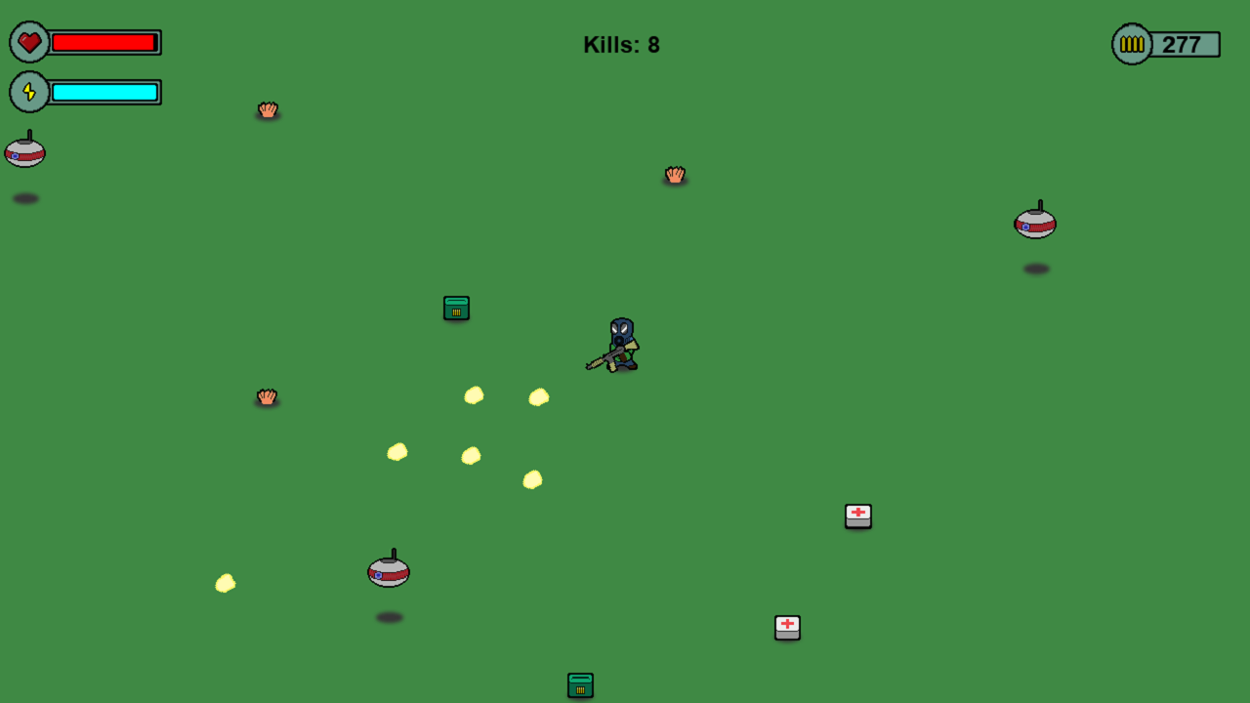
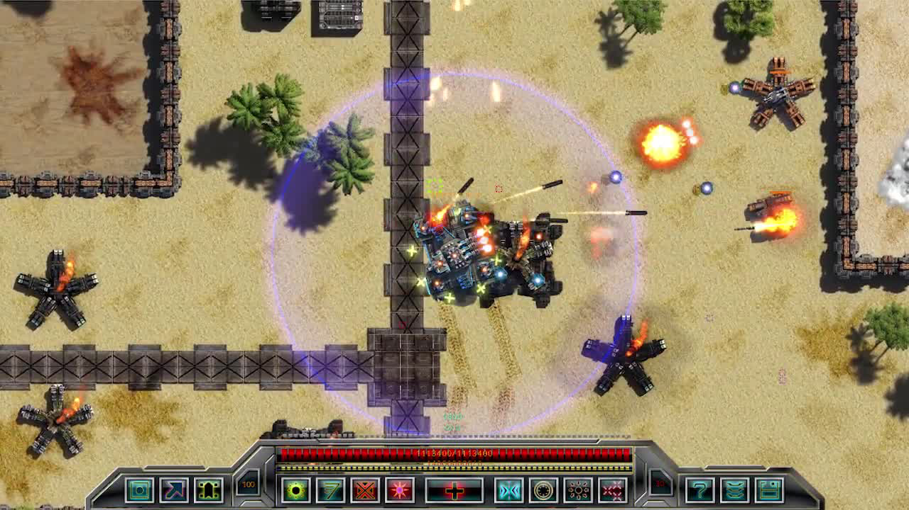
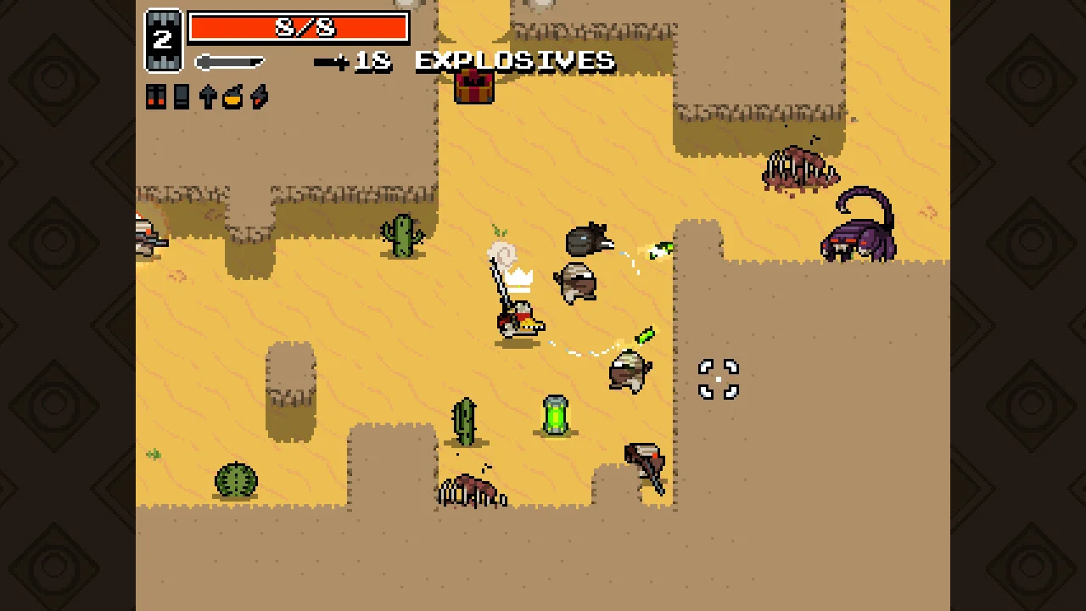
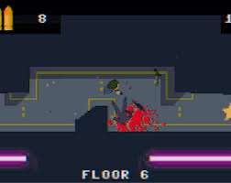
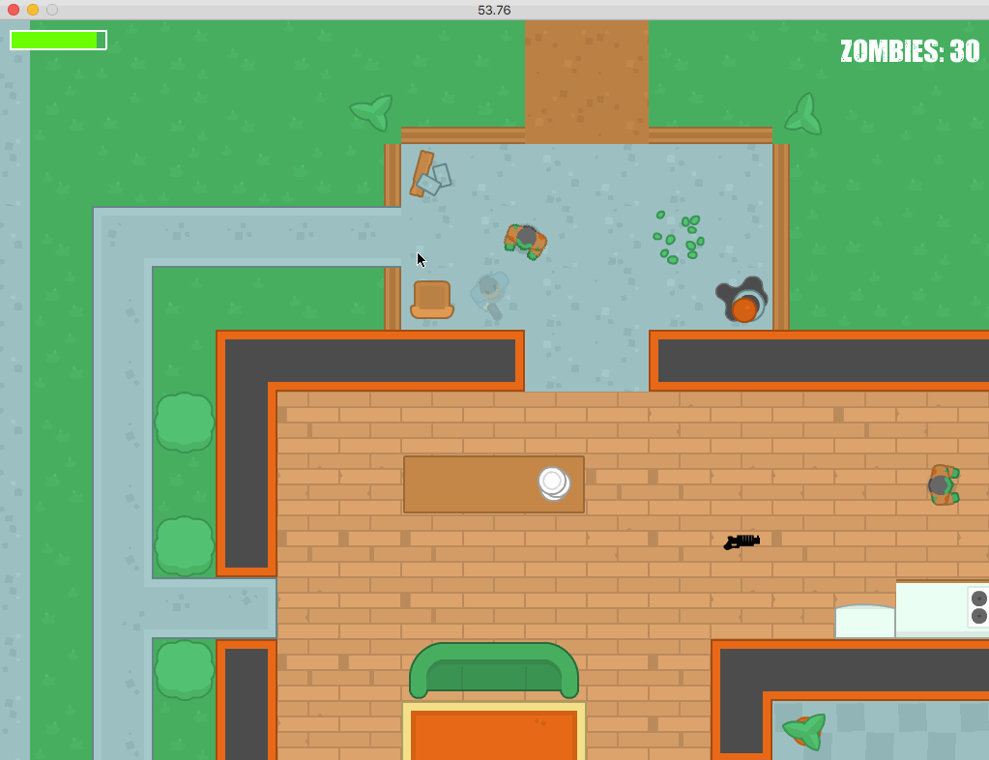
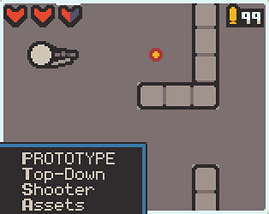
Project4:
Tile-Based Topdown Shooter

Slide 2
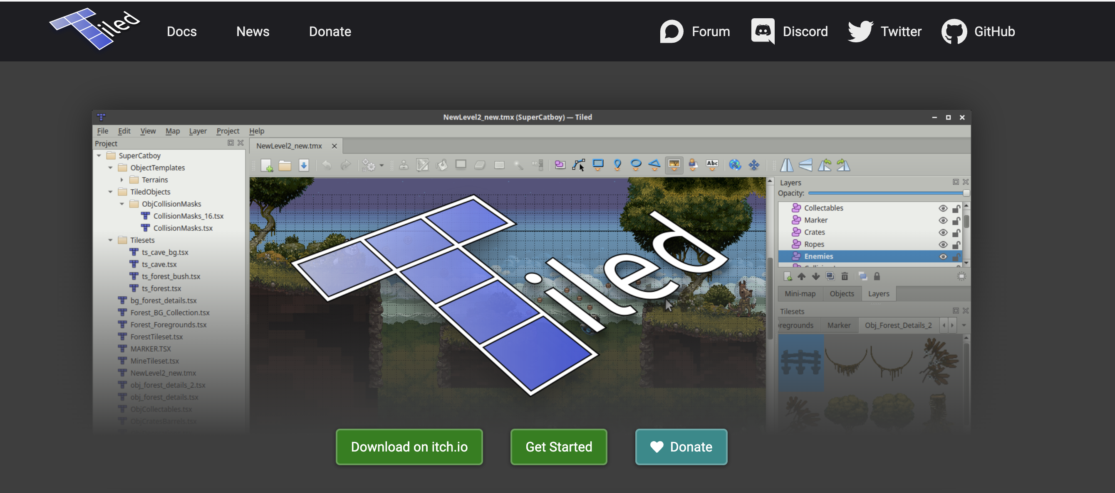
1. Creating the Map
https://www.mapeditor.org/
Creates a tmx file
Which can be read in python
Using the pytmx package

Slide 3
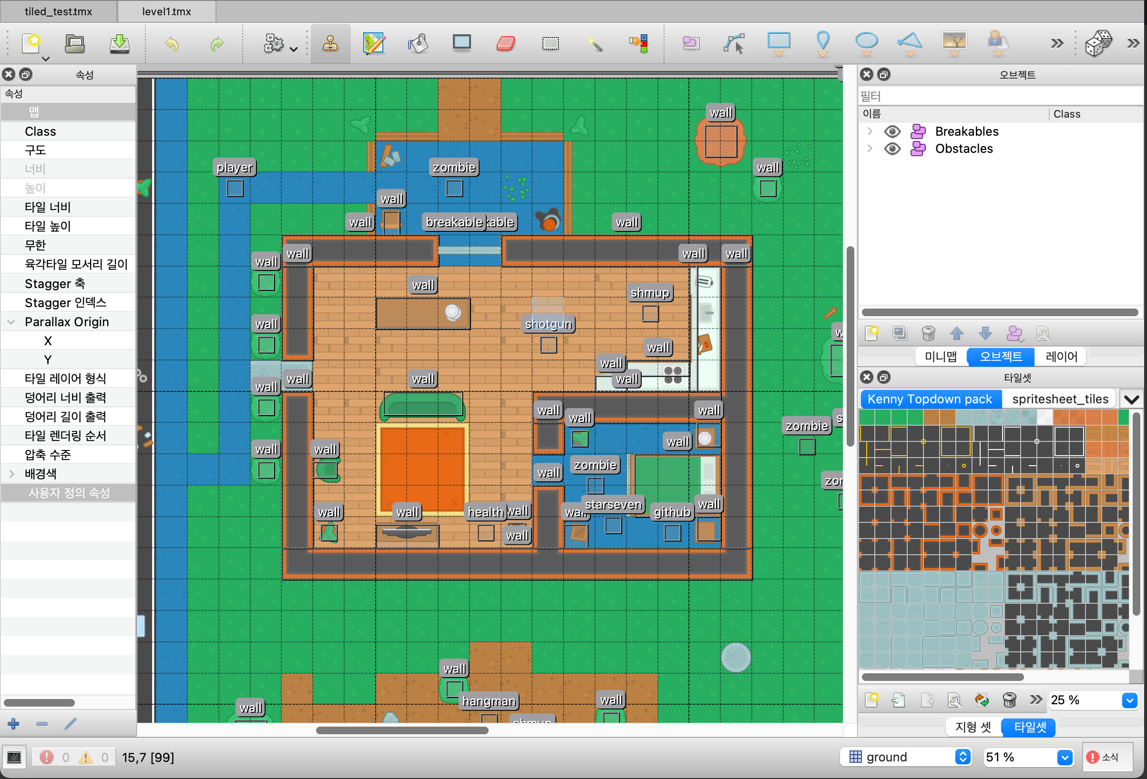
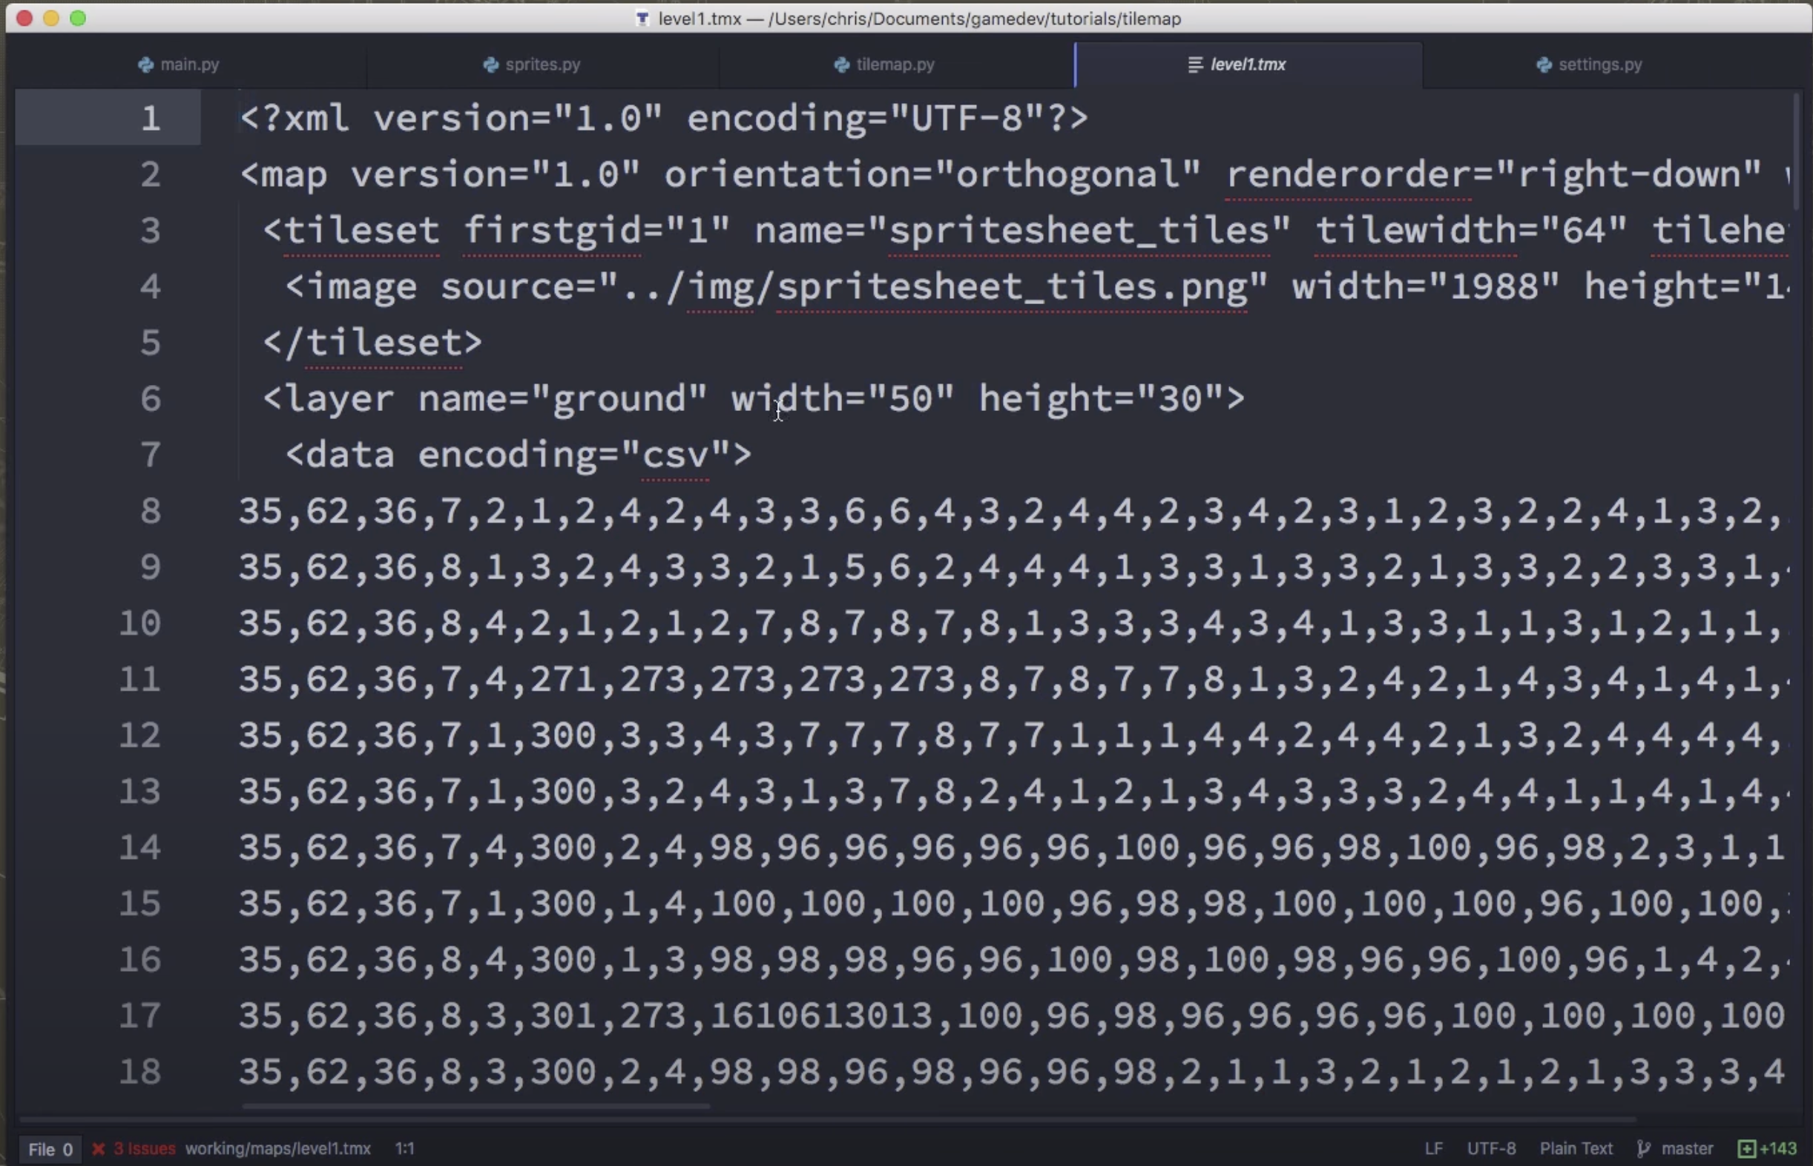

Slide 4
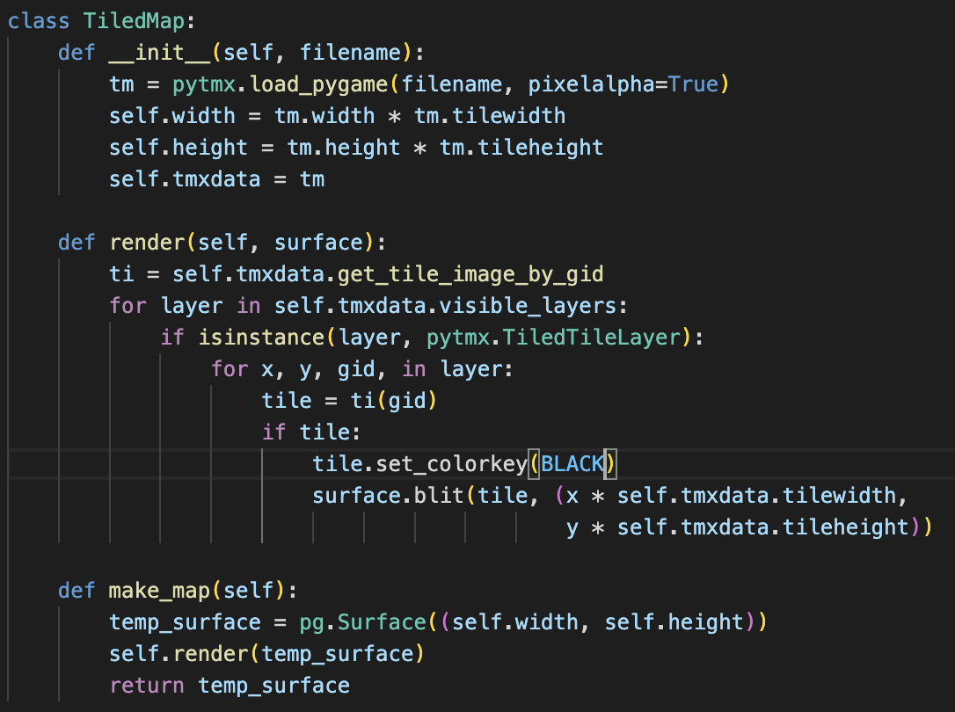
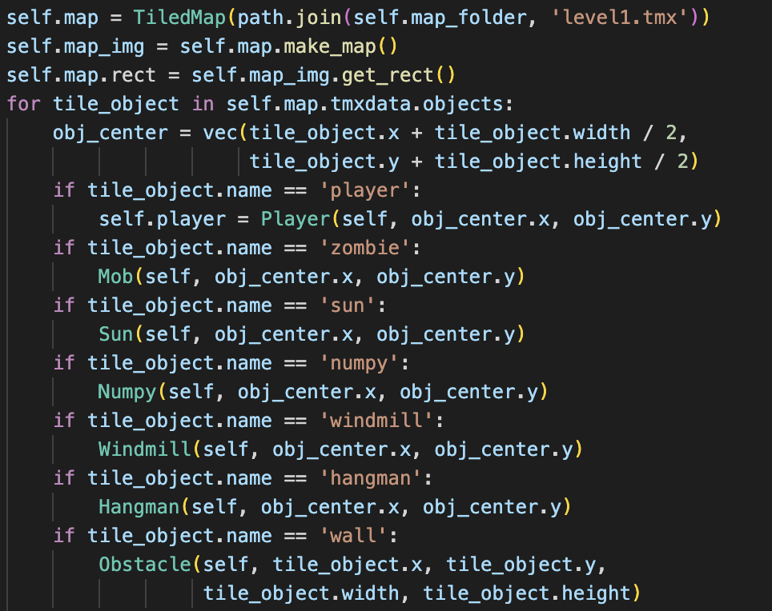
Map will be rendered into image, and instances in will automatically be located
where they were placed during map design Ex)

Slide 5
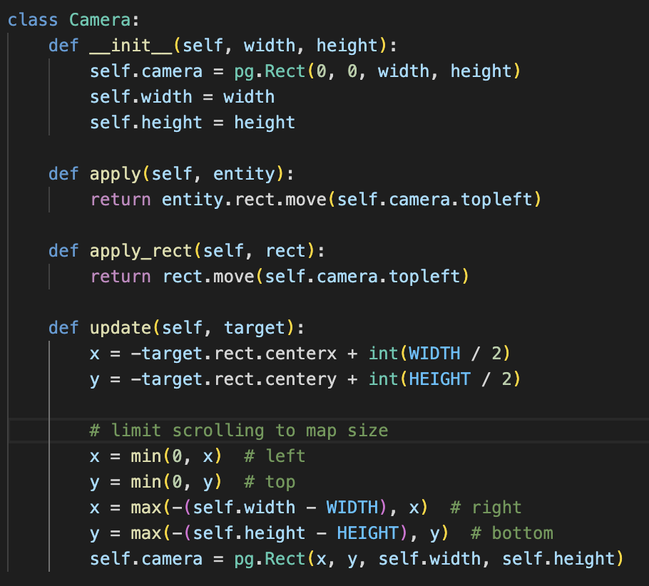
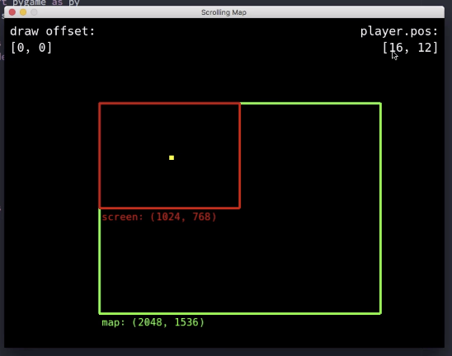
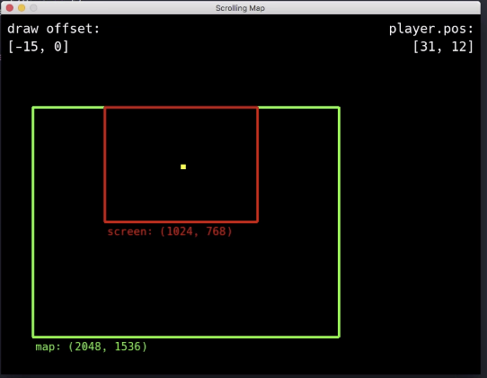
Map Scrolling
It looks like there is camera following the moving player,
but the player is actually still, and the map around it is shifting
‘Camera’ follows a target, and its left top location updated a certain amount depending on where the target is. Then it applies the movement to the rest of the entities

Slide 6
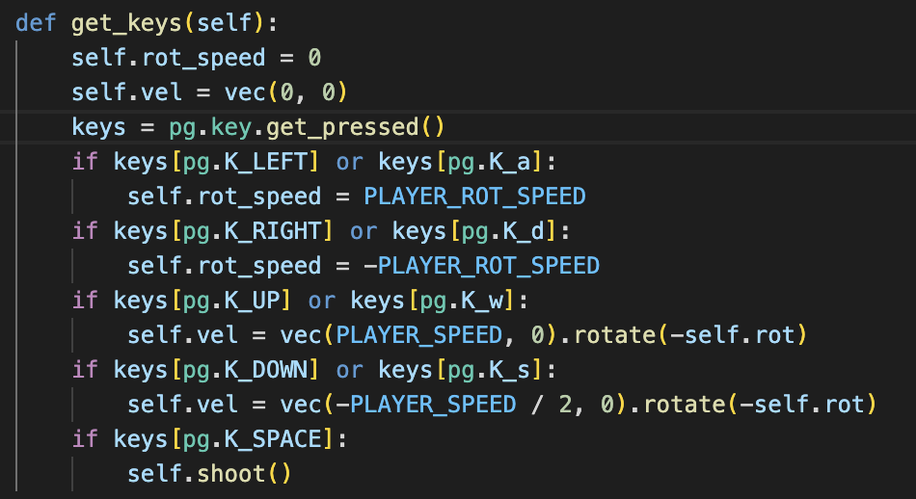
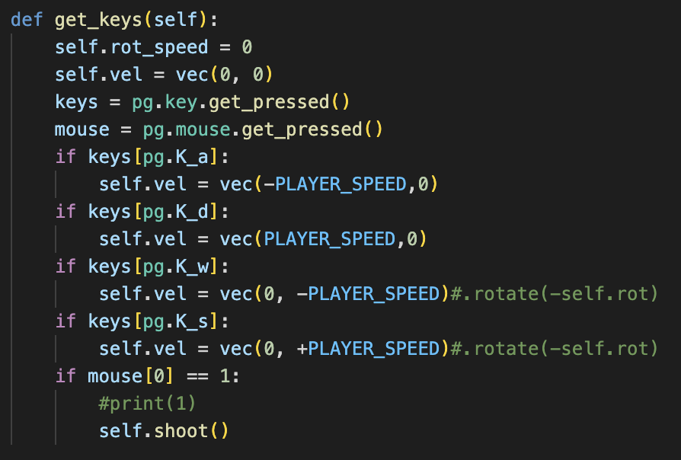
Improved Move/Shoot Controls
The original game used L, R arrow keys to rotate the player,
And U D arrow keys to move it front or back depending on its relative angle
However, this is very hard to control -> Change to WASD Movement, Mouse to shoot

Slide 7
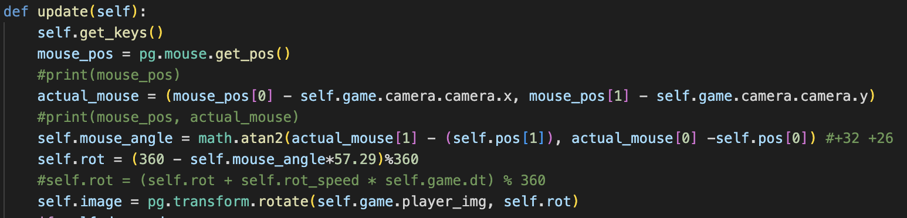
Rotation Method While Scrolling
Player will rotate depending on where the mouse is
However, the mouse coordinates returned by pg.mouse.get_pos() only return the relative location of the mouse on the current VISIBLE SCREEN.
Therefore we must subtract the cameras’ current topleft x,y coordinates in order to make it work while scrolling

Slide 8
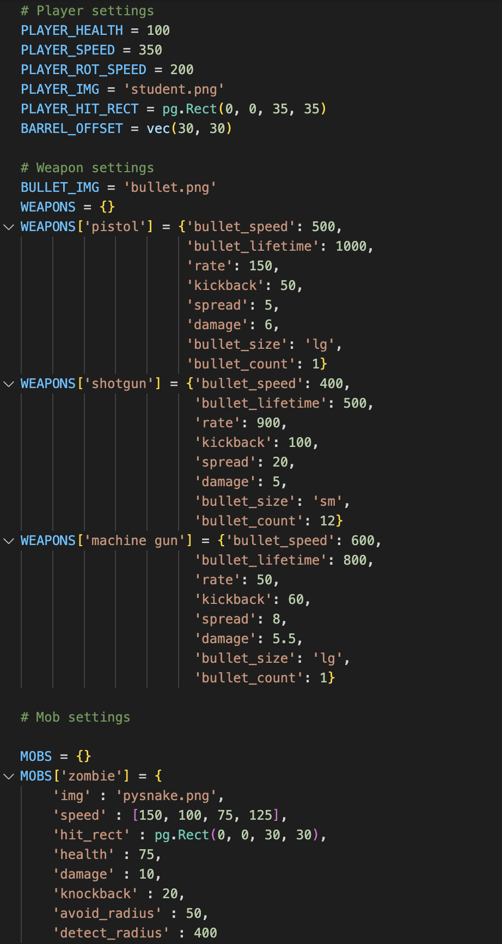
Settings.py
Contains all necessary info of game including sprite health, speed, gun damage etc

Slide 9
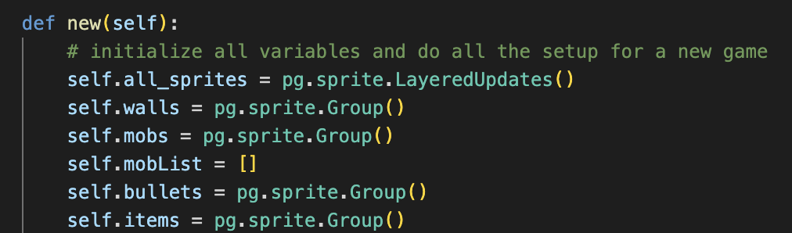
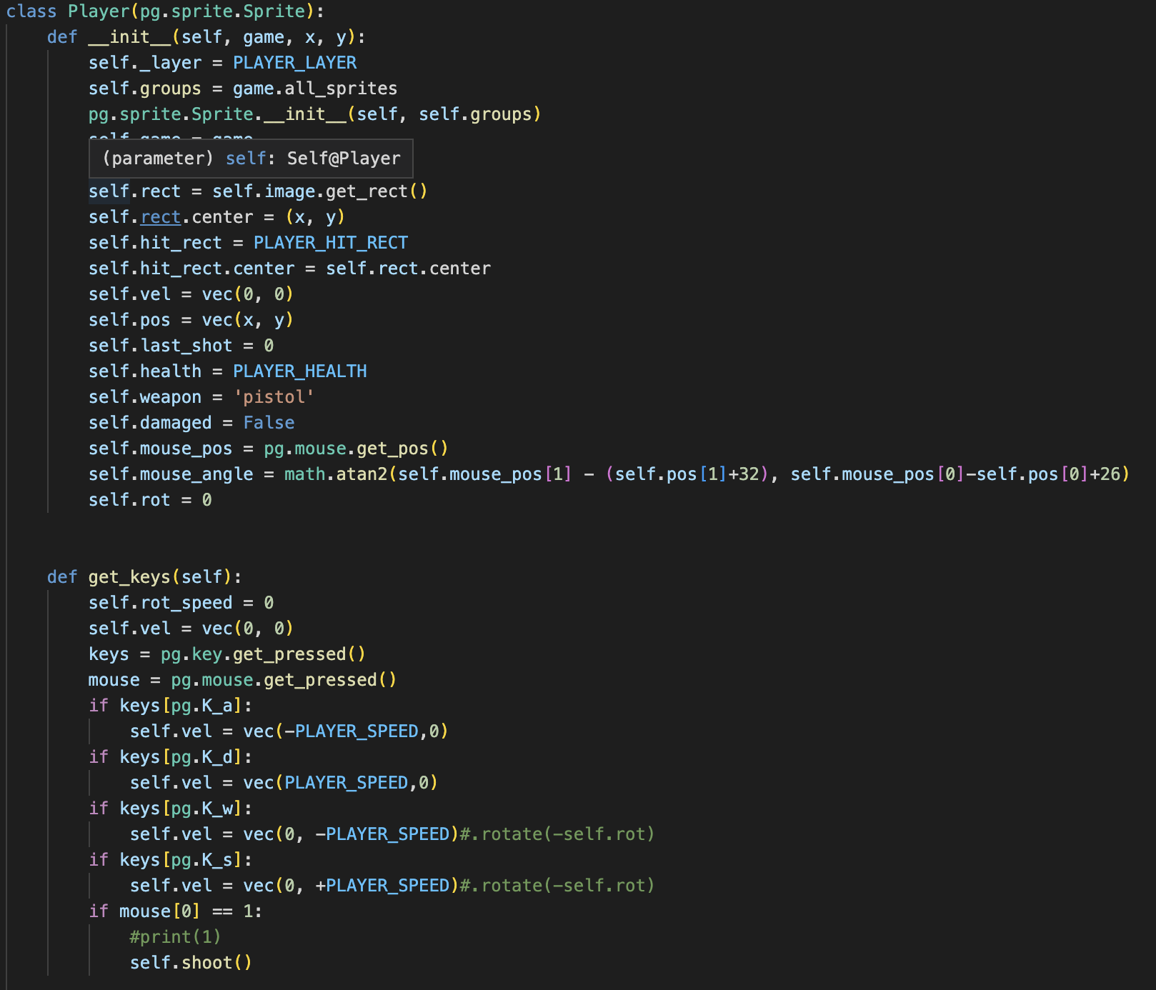
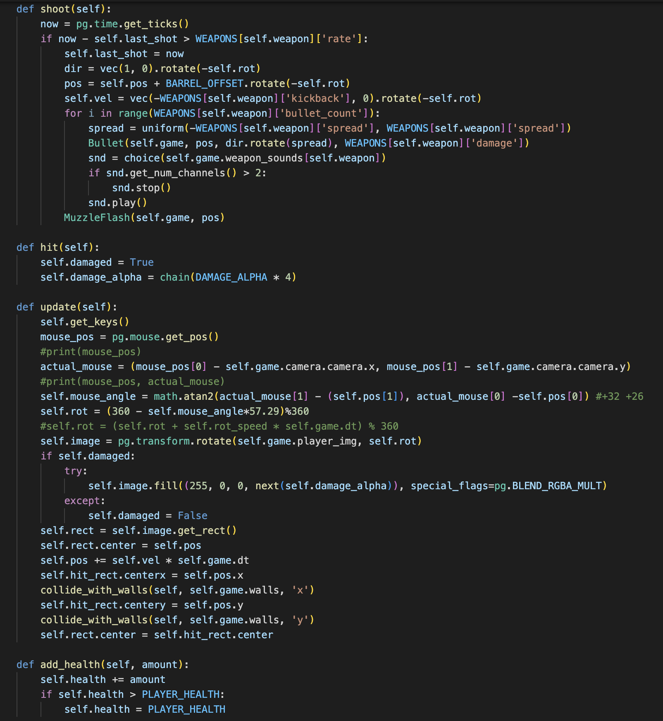
Sprites - Player

Slide 10
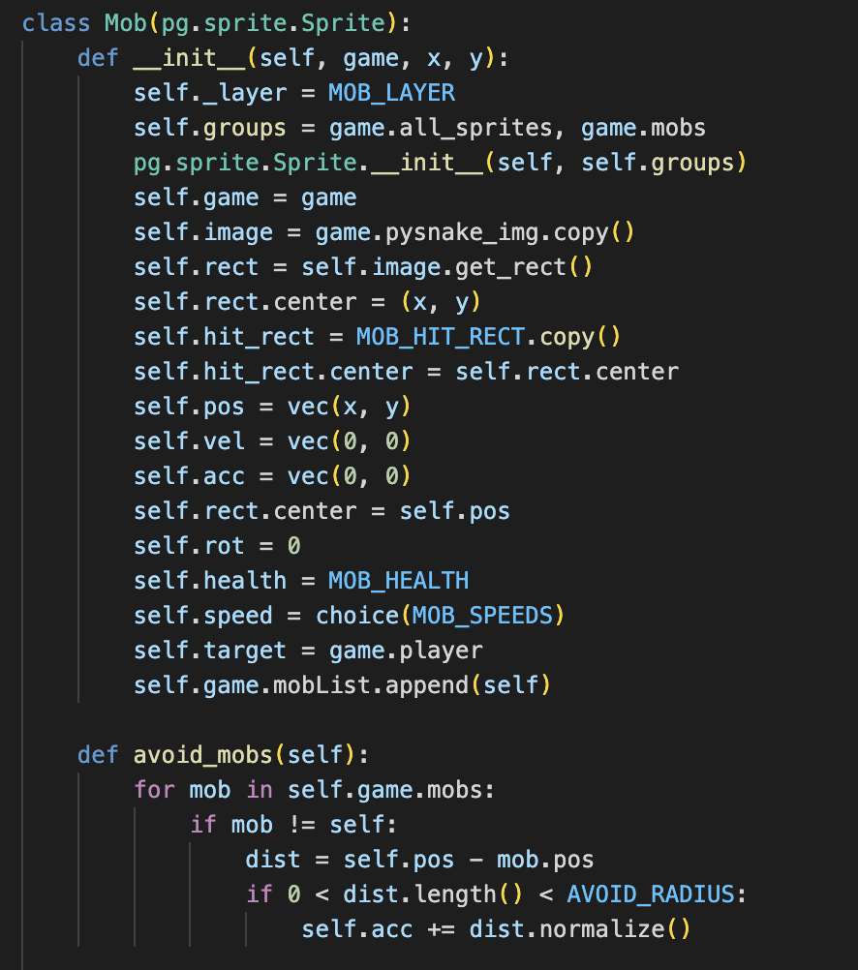
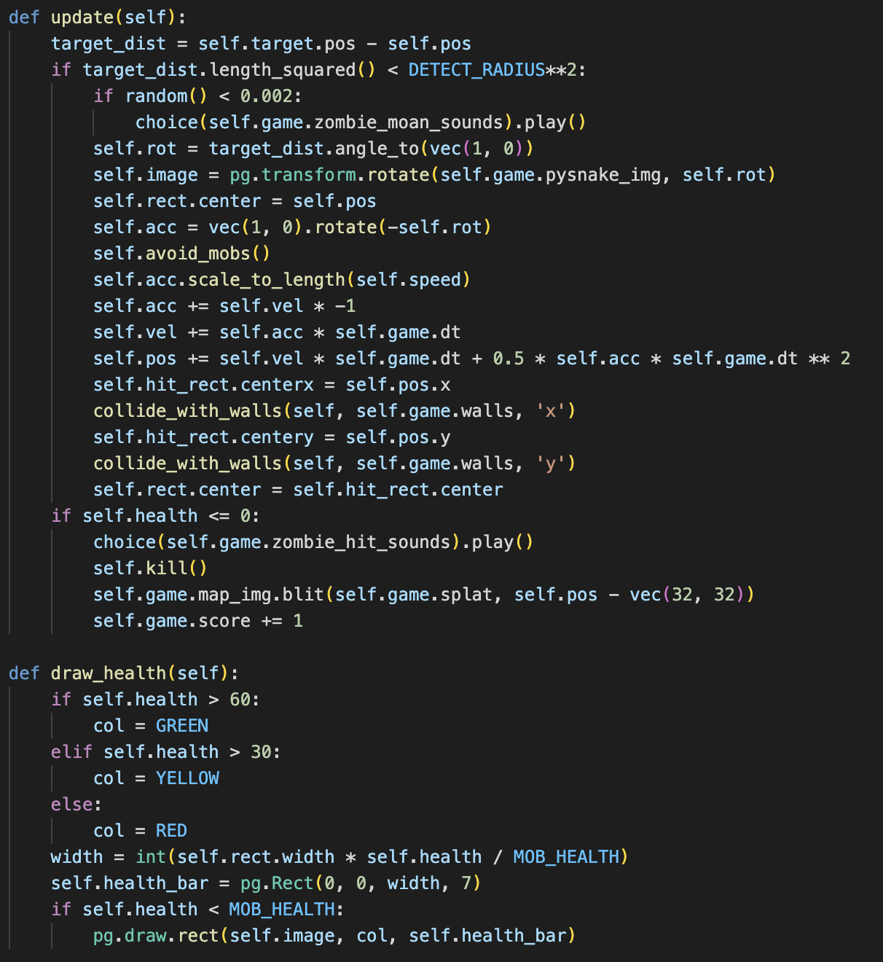
Sprites - Mob

Slide 11
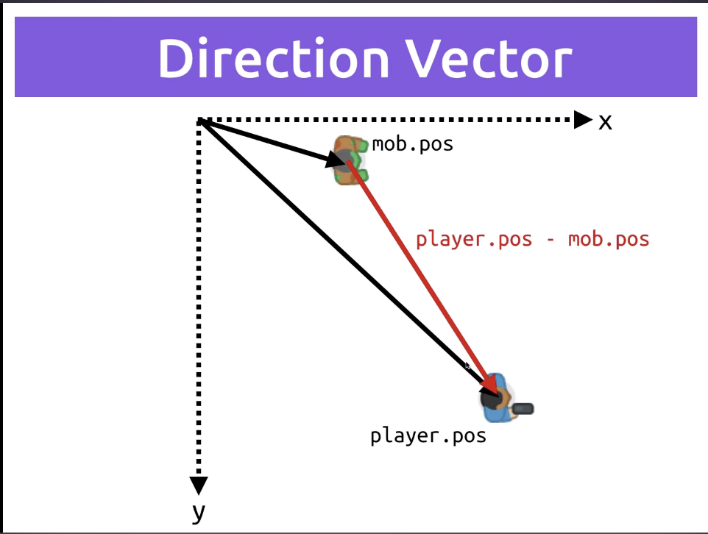
Mob Movement – Chasing Player
Speed and Velocity are stored as vectors. Each mob is given a DETECT_RADIUS
If player is within detection radius, we make the mob move to the player’s direction, calculating their location by subtracting player.pos – mob.pos

Slide 12
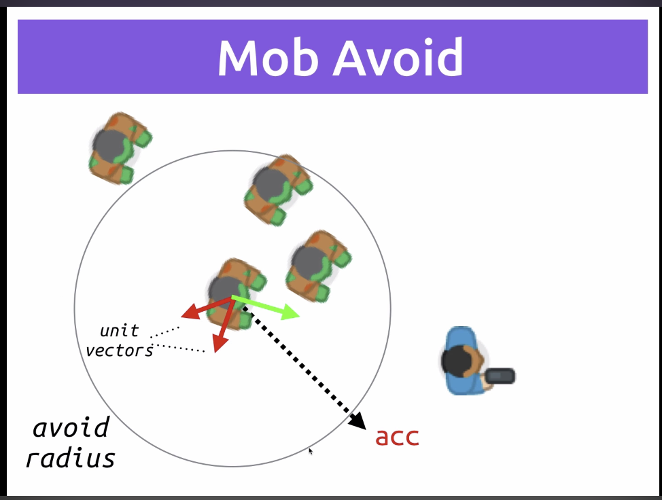
Mob Movement – Improved
After a while mobs get mushed into one location because they all get the same velocity vector from the player. In order to solve this, we give each mob AVOID_RADIUS, and if there are other mobs in the radius, we calculate the unit vectors between target mob and invading mobs, and calculate direction by adding all three

Slide 13

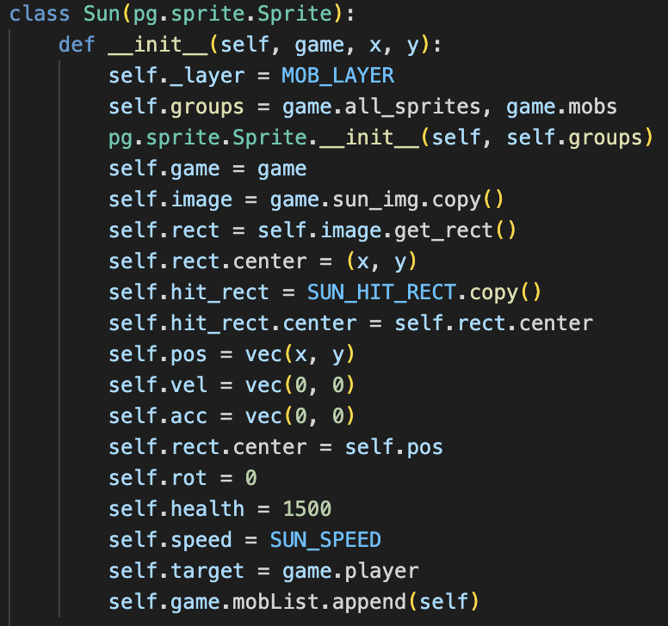
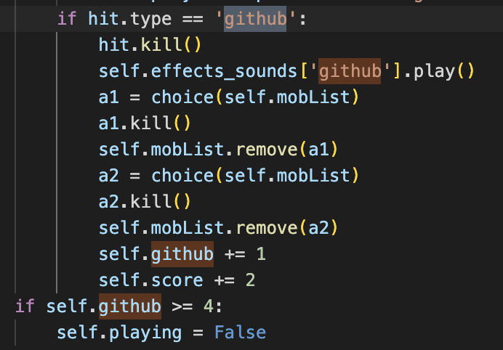
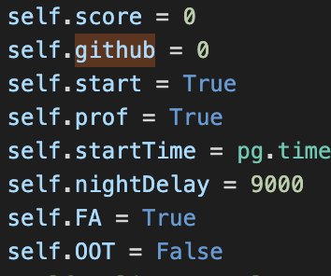
Items - Github
- Randomly Chooses 0 ~ 2 Mobs and kills them
- Problem: you cannot apply random.choice to sprite groups
Solution: When you create mobs, append them to a
separate list, and apply random.choice to that list

Slide 14
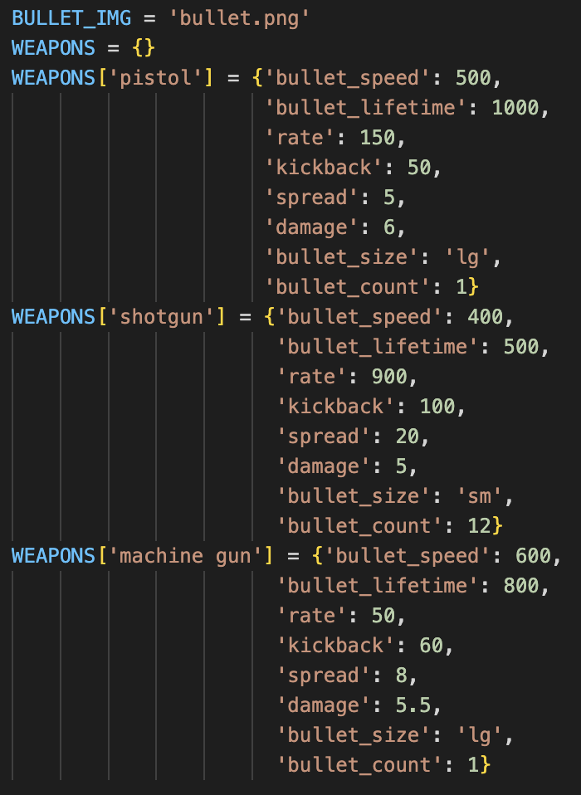
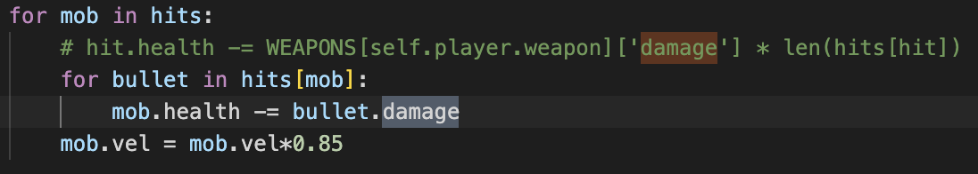
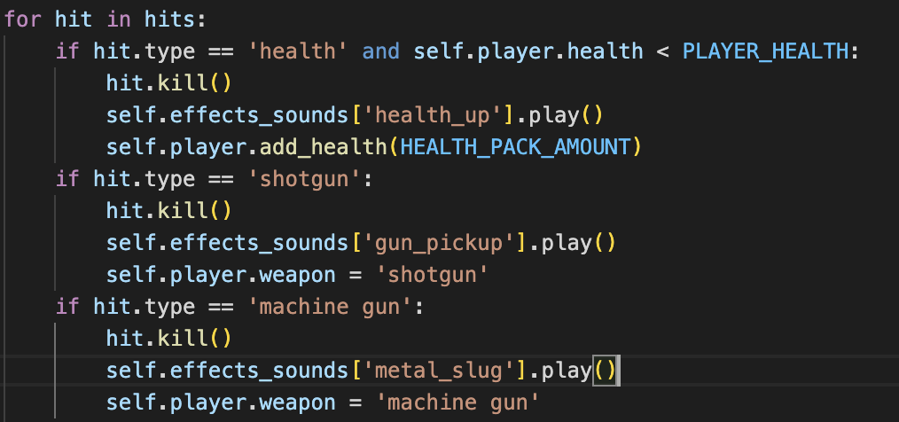
Items - Guns
- Info of guns stored in dict in settings.py

Slide 15
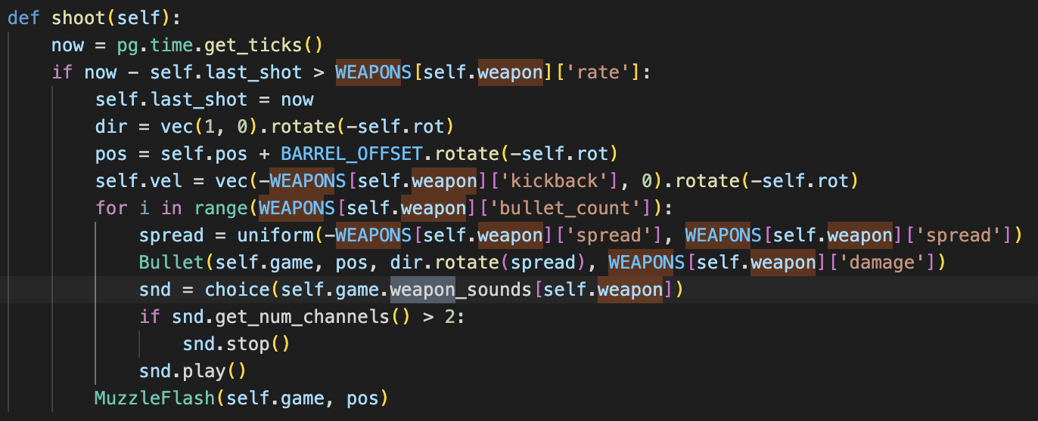
Items - Guns
- Rate
- Kickback
- Bullet_count
- Spread(Rotation for Inaccuracy)
- Range(Duration)
- Damage

Slide 16
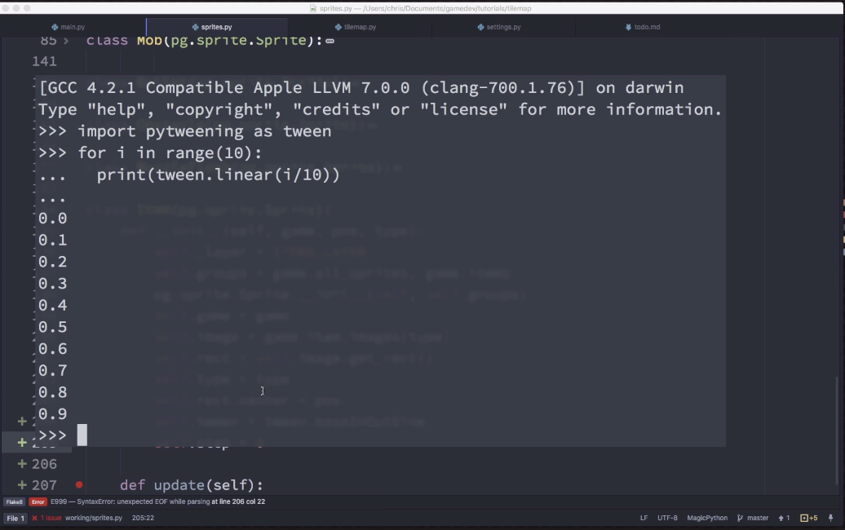
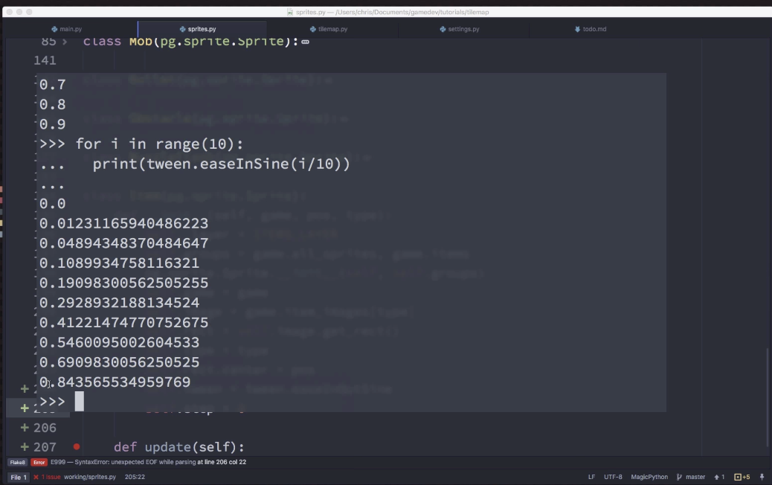
Items – Bouncing: Tweening/Easing
https://gamemechanicexplorer.com/
- Using the pytweening package
- Tweening allows us to move through a range in different rates

Slide 17
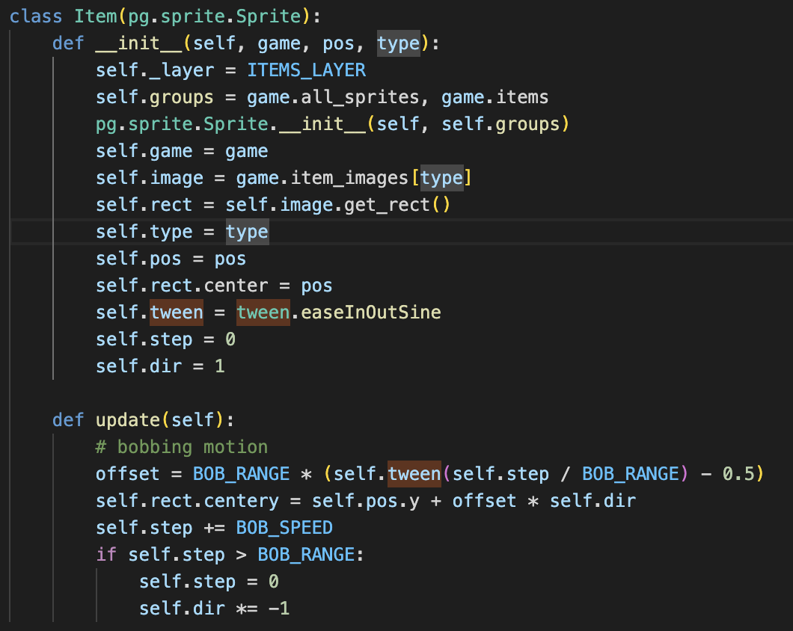

Slide 18

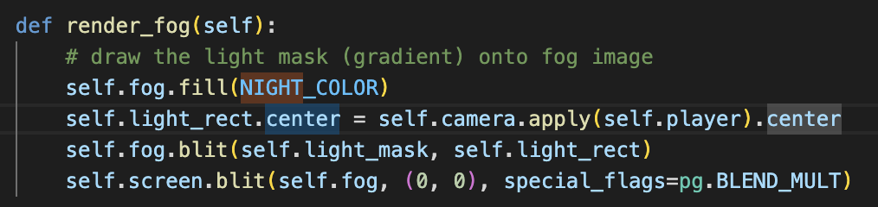
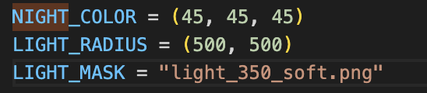
Night Mode
Draw color over entire screen with special_flags
Set as BLEND_MULT
light_350_soft.png

Slide 19
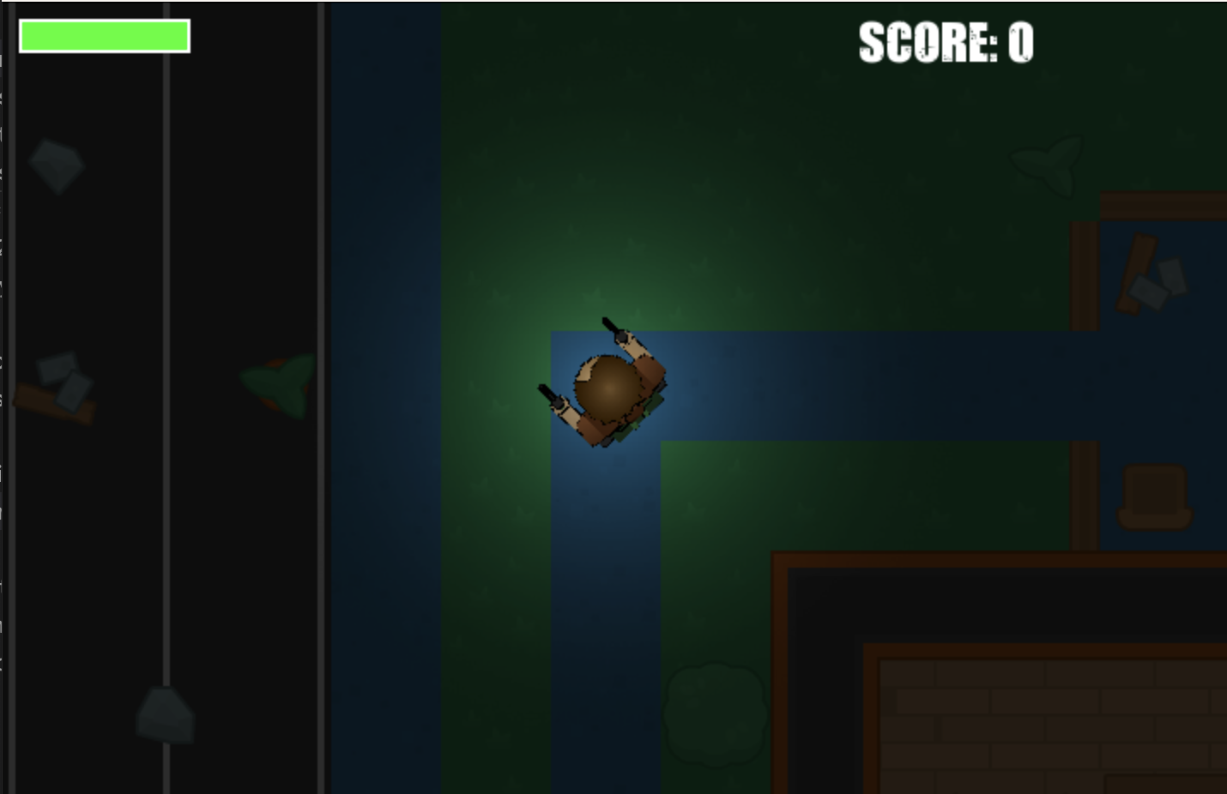
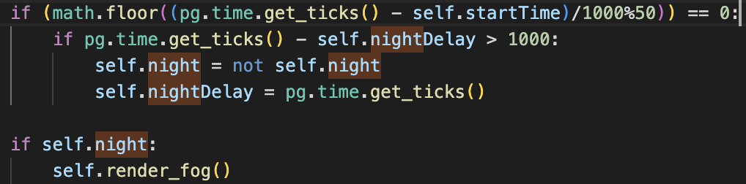
- Night mode is toggled every 50 seconds.
- Therefore 1 Day is 100 seconds

Slide 20
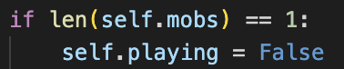
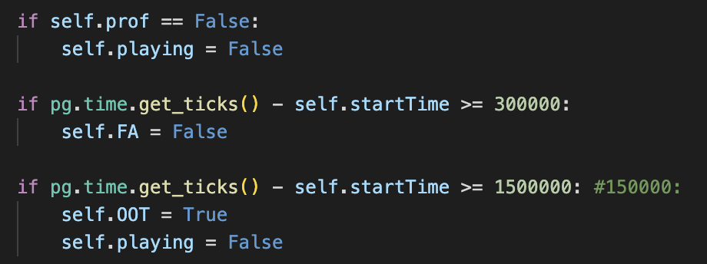
Ending Conditions
If all assignments are dead
If Professor if defeated
If 1500 seconds (15 Days) have passed
If you don’t make it through 300 seconds (3 Days), you get an F/A

Slide 21
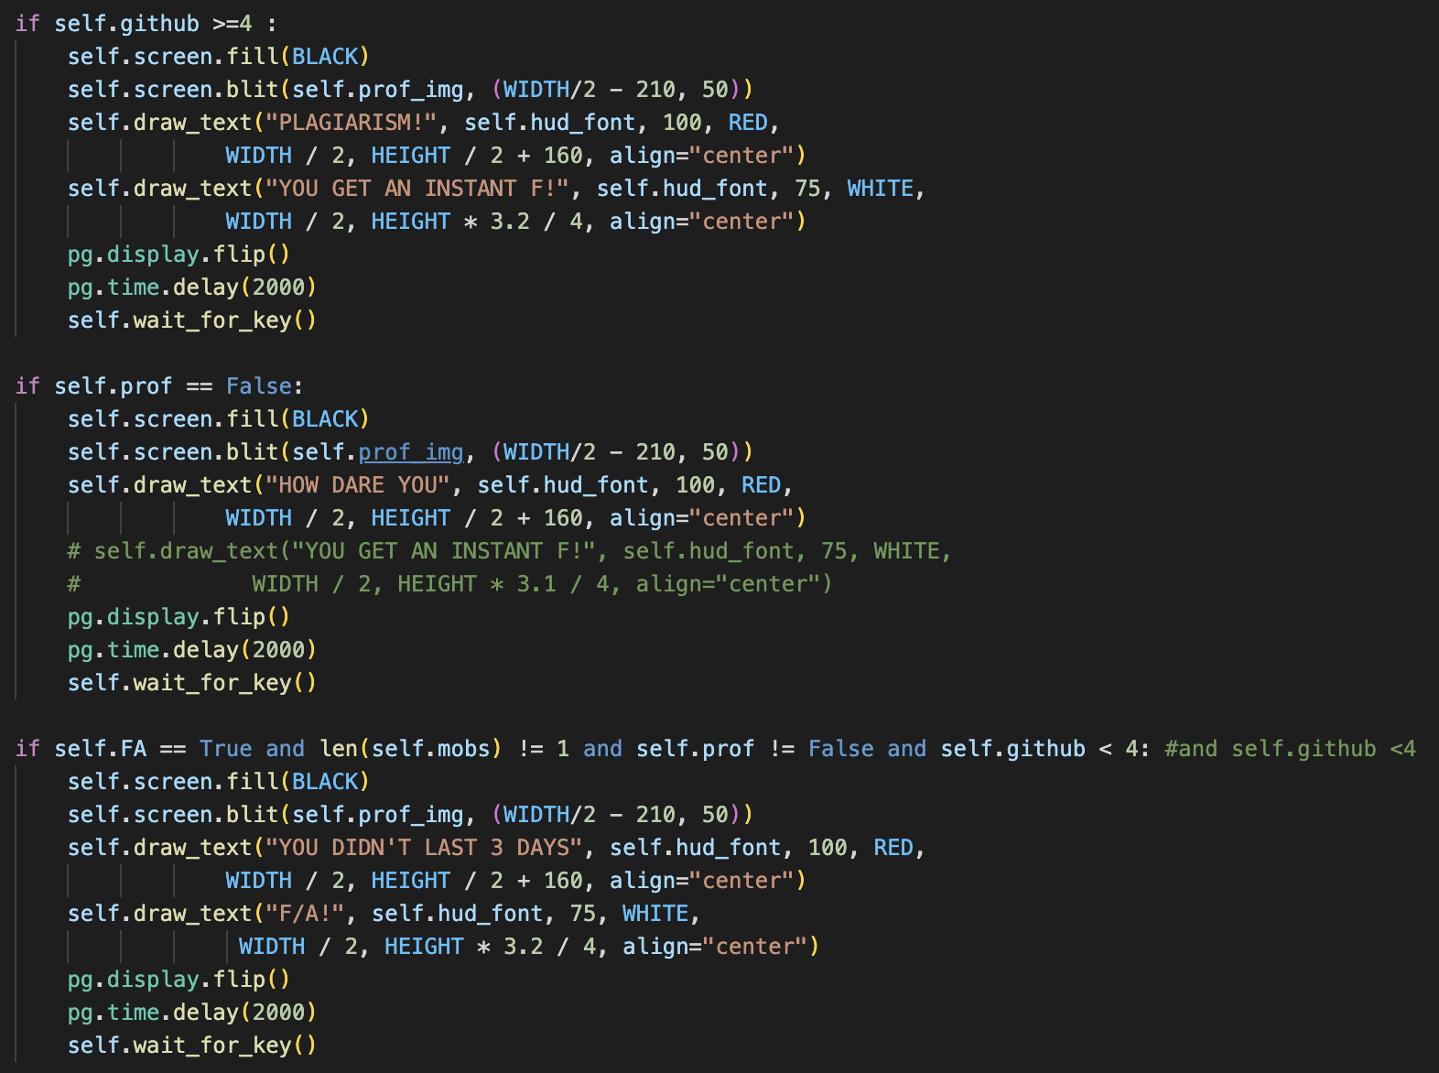
Ending Conditions – End Screen
Different end screens depending on how the game ended

Slide 22
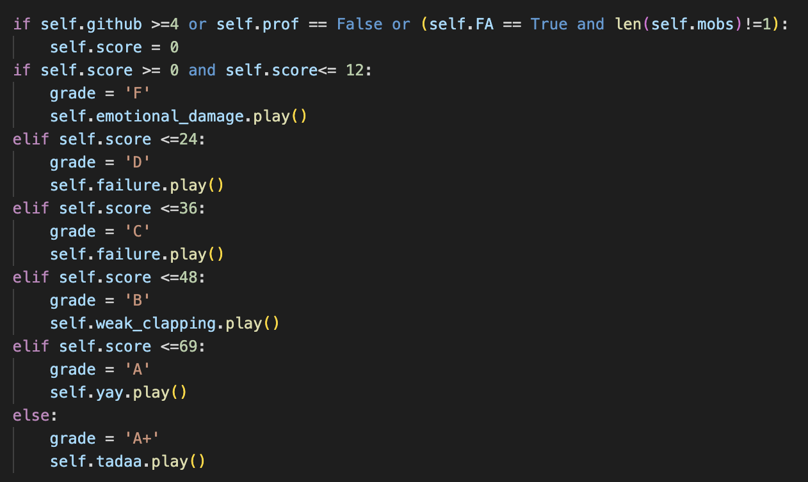
Ending Conditions - Grades
Points per Mob
Pysnake: 1
Shmup: 1
Hangman: 1
Numpy: 2
Windmill: 3
Stars1~7: 1,2,5
Sun: 10
You must kill all assignments WITHOUT using any Githubs to get A+

Slide 23
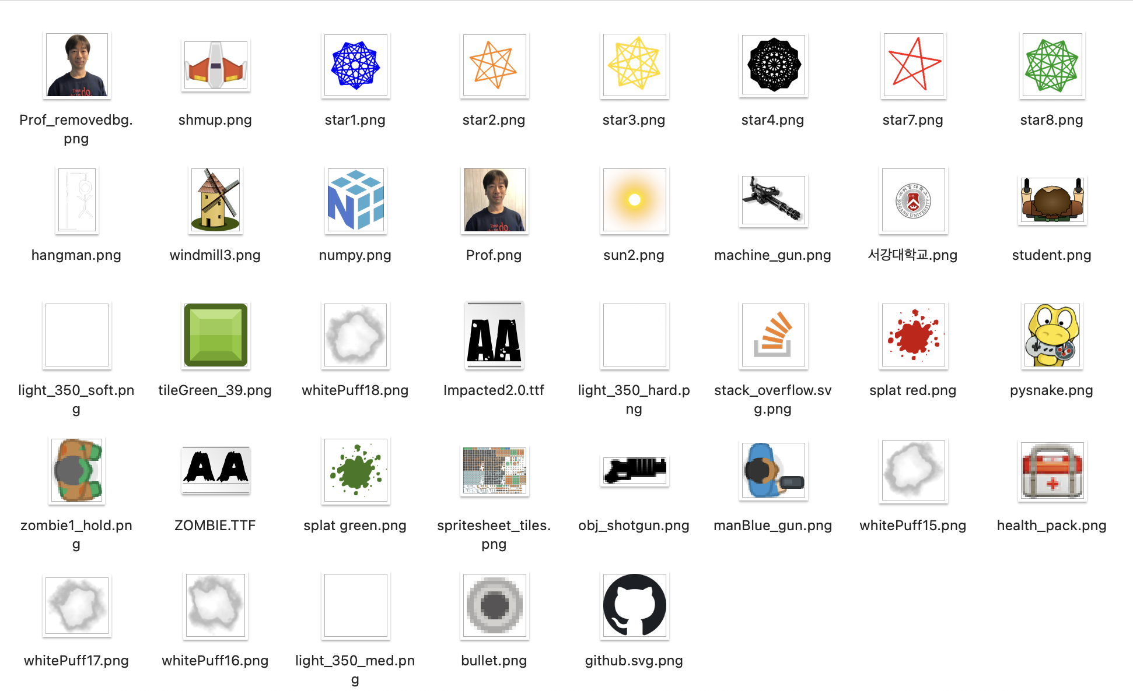
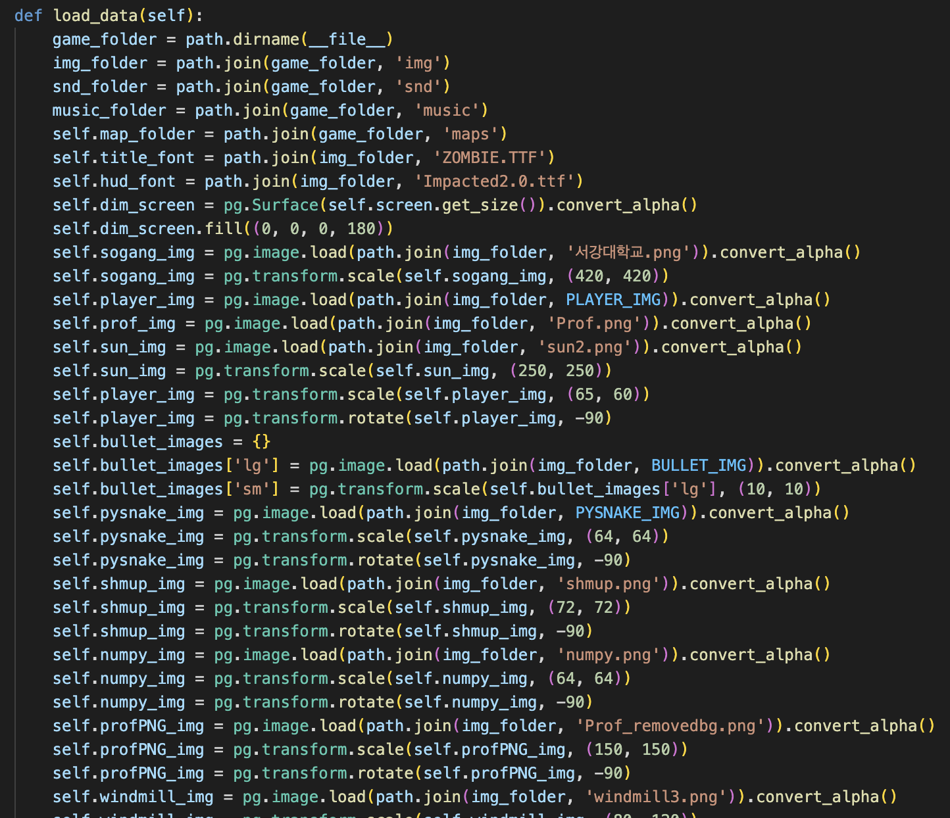
Assets

Slide 24
Basis & References
https://kidscancode.org/lessons/
https://github.com/kidscancode/pygame_tutorials
https://www.youtube.com/@Kidscancode
https://www.youtube.com/@zacharystolter5502

Slide 25
Improvements
Several waves instead of 1 big game?
Power ups? (PngEgg -> Increase speed, Invinsible etc)
Some Animation?
Different Weapons?
Change Pointer Image?
A mob that shoots?
Typing minigame?
https://github.com/lukekwon98/Introduction-to-Visual-Media-Programming/tree/main/Project4_Testing/part%2023%20LIghting%20Effect

